Slide 1
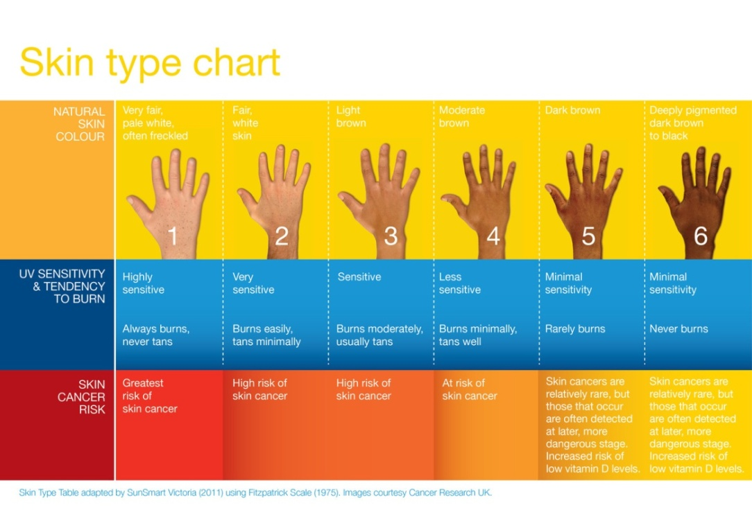
Fuel Your Body to Win
Let’s Get Healthy! visited La Grande, Oregon on February 23rd and 24th, 2015
and collected research data from 805 middle school students from
Cove, North Powder, Elgin, Union, Imbler, and La Grande.
52 students completed the skin cancer station and their results are shown below.
Skin cancer is the MOST COMMON
of all cancer types
Anyone can get skin cancer.
Skin cancer risk is influenced by your genetics, skin type and your protection behaviors.
If you have a sensitive skin type (Fitzpatrick Type 1-3), you need to be especially cautious!
Individuals with darker skin (Fitzpatrick Types 4-6) are still at risk! People of color are often diagnosed later, which means the cancer can become more advanced and potentially fatal.
Regular skin checks are important for everyone!
Most skin cancers are curable if caught and treated in a timely manner.
Did you know? Legendary reggae musician Bob Marley dismissed a spot under his toenail as a soccer injury, but it turned out to
be an aggressive form of melanoma
that ultimately caused his death at 36.
FITZPATRICK SKIN TYPES OF LA GRANDE
Just 10% of the La Grande area students who completed the survey had “excellent” or “good” sun safety behaviors!
In the last year, 77% of La Grande Middle School students went to a doctor’s office for a checkup
To see more results from your school and others, please visit: http://www.letsgethealthy.org

