Slide 1

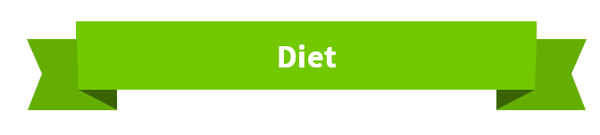
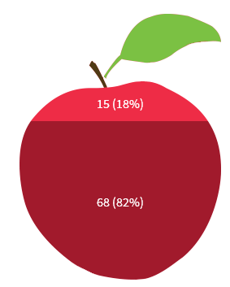
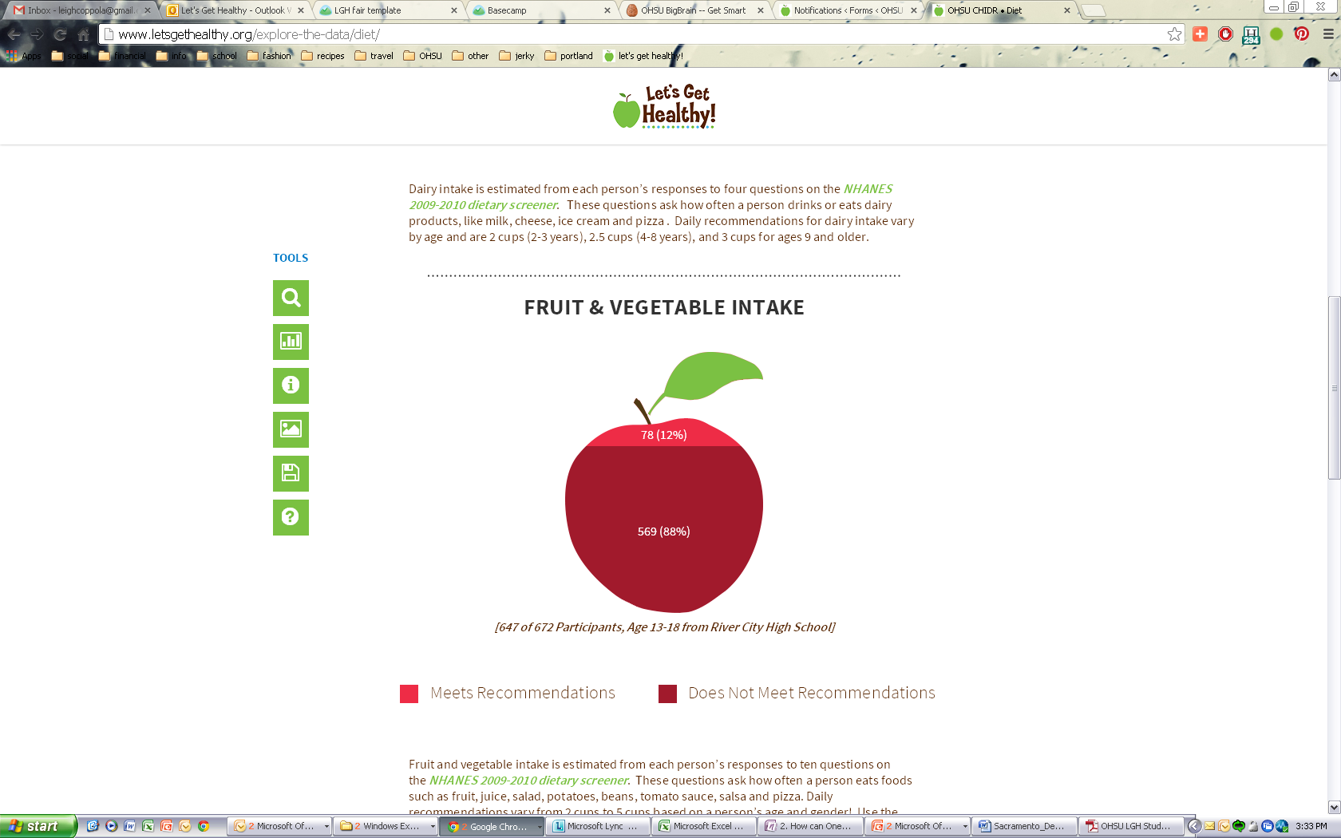
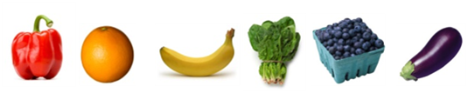
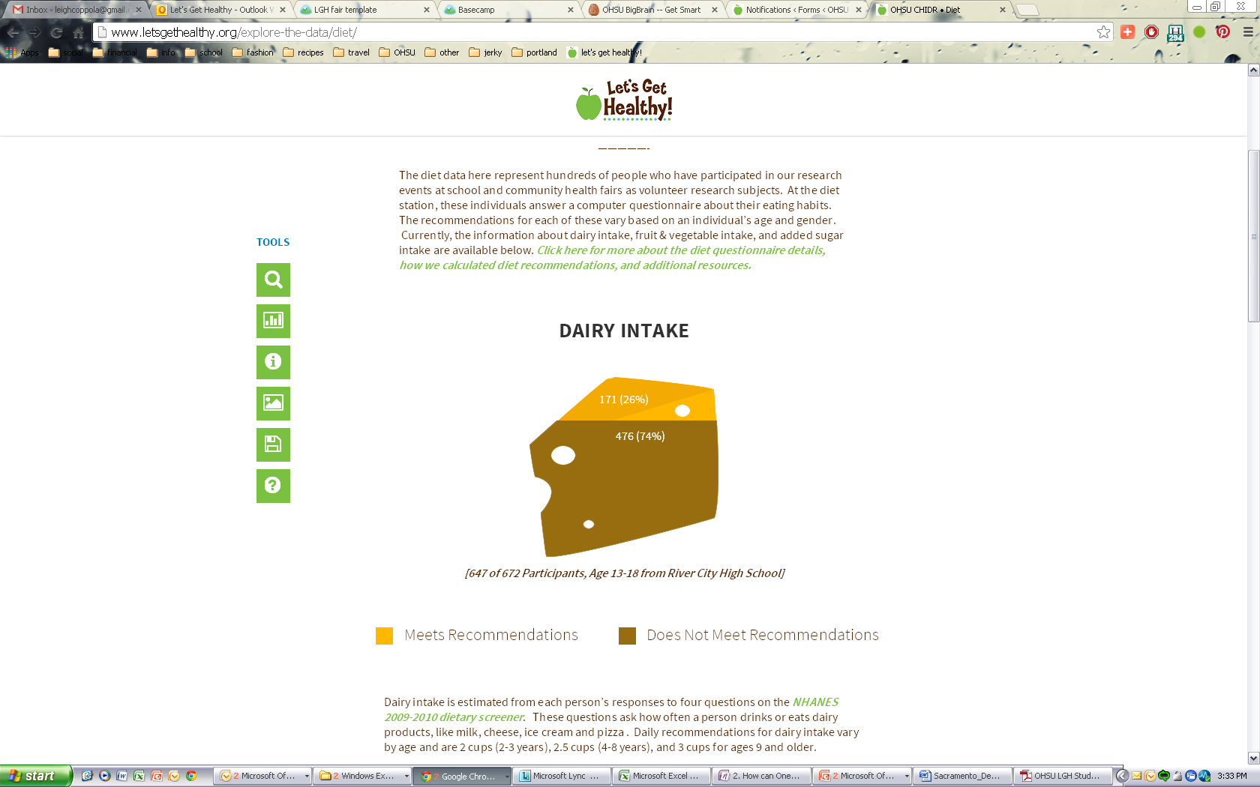
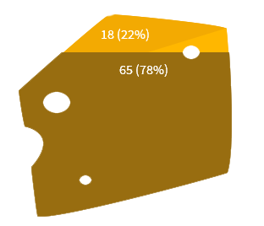

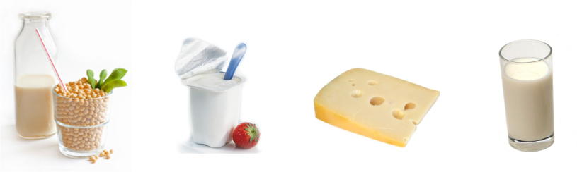






Self Enhancement, Inc.
Let’s Get Healthy! visited Self Enhancement, Inc. on December 5th, 2013 and collected research data from 278 SEI students and community members.
83 students completed the diet station and their results are shown below.
MALES
Daily Fruit & Vegetable Intake
FEMALES
5 cups
2.6 cups
4 cups
2.7 cups
Recommended for 10-14 year olds
Average for SEI Students
Only 18% of participants meet daily fruit and vegetable recommendations.
Breakfast
61% of students decide for themselves what they eat for breakfast.
Lunch
41% of students said that the school decides what they eat for lunch.
Dinner
Four fifths (80%) said that their parents decide what they eat for dinner.
One in ten students said they “never” or “rarely” eat breakfast.
Two thirds (67%) of students said they think about what they eat most days.
More than 9 out of 10 SEI participants consume more sugar than recommended!
Did you know?
It is recommended that females consume less than 6 teaspoons per day and males consume less than 9.
2.5x
Only 5% of students thought that students in their school would meet recommendations for healthy diet. More than one third (38%) of students said they thought their own diet would meet recommendations.
On average, at SEI, students are consuming 2.5 times more sugar than recommended.
To see more results from your school and others, please visit: http://www.letsgethealthy.org

