Slide 1
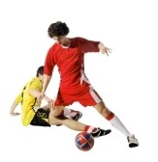
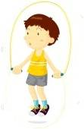
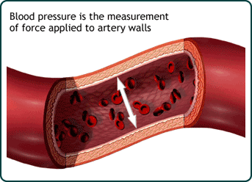
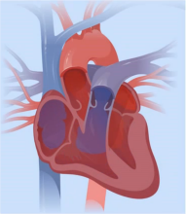
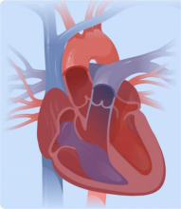
Self Enhancement, Inc.
Let’s Get Healthy! visited Self Enhancement, Inc. on December 5th, 2013 and collected research data from 278 SEI students and community members.
126 students completed the blood pressure station and their results are shown below.
13% of students said they had “no idea” about how healthy their blood pressure may be!
What is blood pressure?
Blood pressure is a measurement of how hard your heart is working to pump blood through your body. Circulating blood provides your organs and tissues with oxygen and nutrients needed to keep you alive.
Too low?
Low blood pressure is usually OK as long as you aren’t experiencing the following symptoms. Low blood pressure can have an underlying cause.
Symptoms include dizziness, lightheadedness, fainting, unusual thirst, lack of concentration, blurred vision, nausea, cold/clammy skin, rapid shallow breathing, fatigue or depression.
Too high?
High blood pressure is known as “the silent killer” because it can be a sign of blockages within the heart or blood vessels, that can lead to heart attack and stroke.
Symptoms of dangerously high blood pressure include severe headaches, anxiety, shortness of breath and nosebleeds are some of the symptoms of dangerously high blood pressure.
Recommended Blood Pressure for Middle School Students
What do those numbers mean?
Systolic
Systolic Below 117 - 120
Diastolic Below 75 - 80
The top number, which is also the higher of the two numbers, measures the pressure in the arteries when the heart beats (when the heart muscle contracts). Systolic is a risk factor for heart disease and stroke.
Average Blood Pressure for
SEI Students:
102 / 59
Diastolic
Nine out of ten students (92%) said they think about their health at least some days.
The bottom number, which is also the lower of the two numbers, measures the pressure in the arteries between heartbeats (when the heart muscle is resting between beats and refilling with blood).
To see more results from your school and others, please visit: http://www.letsgethealthy.org

