Slide 1

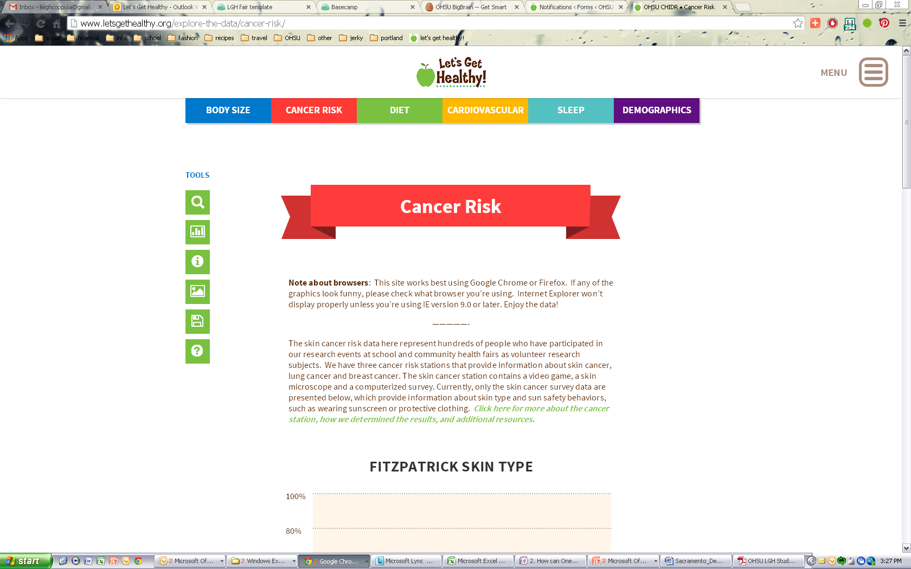
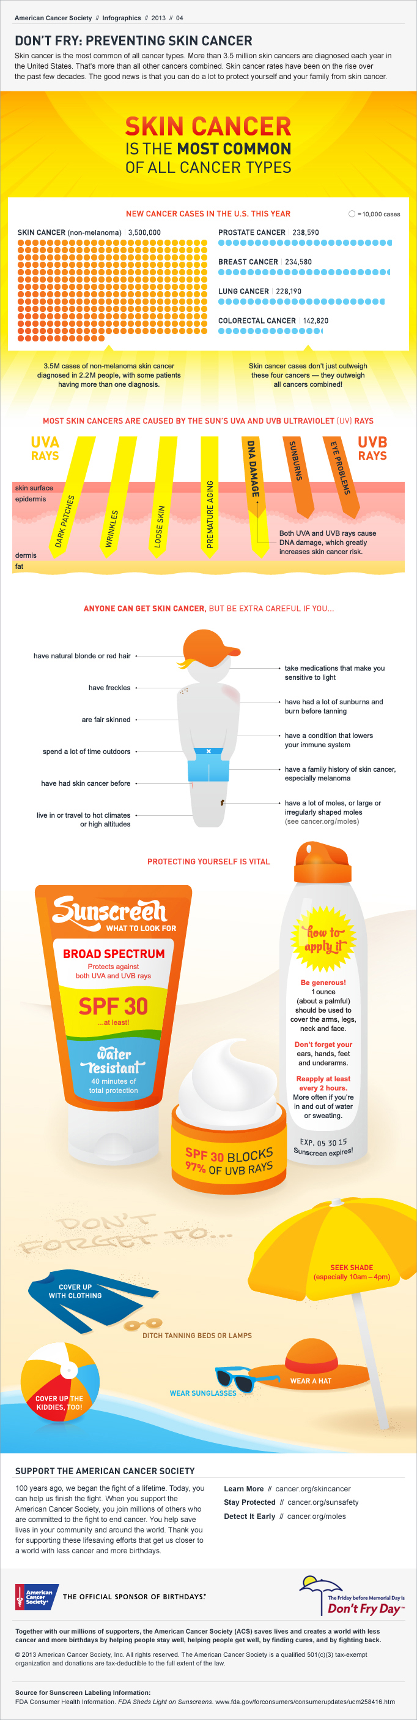

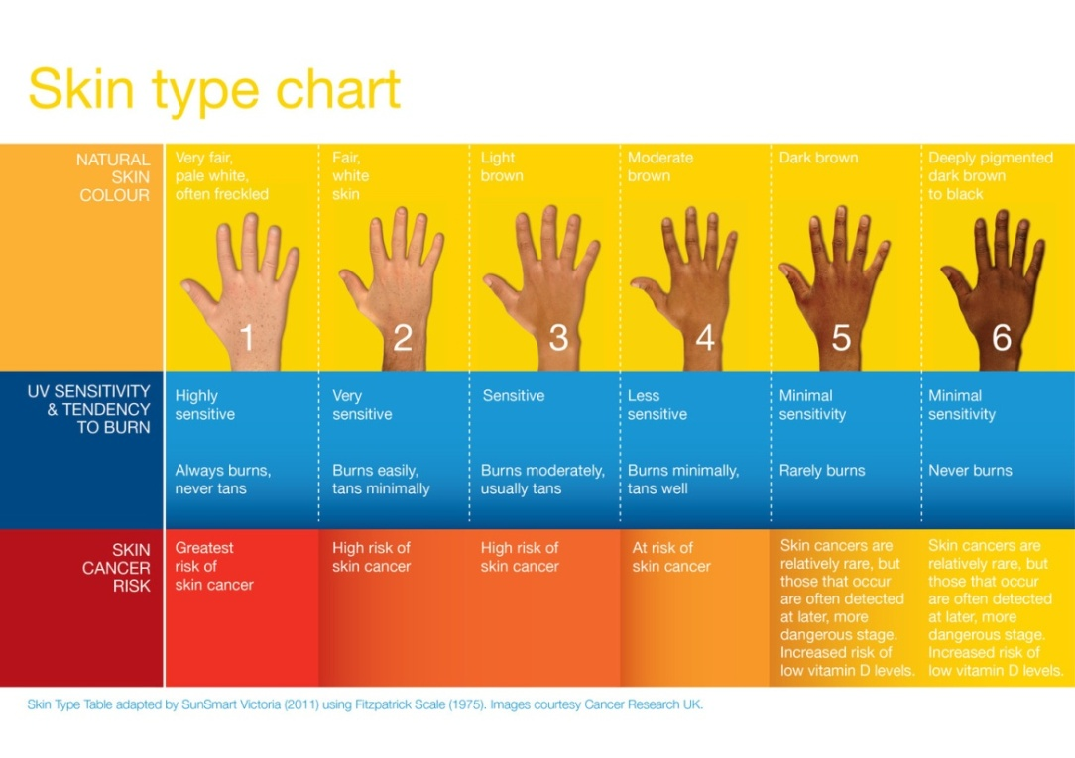
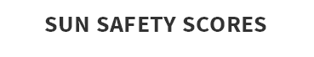
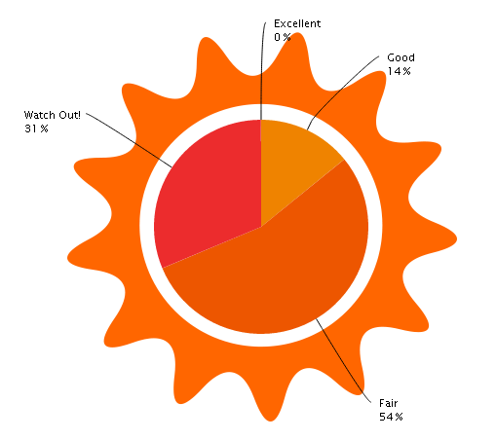
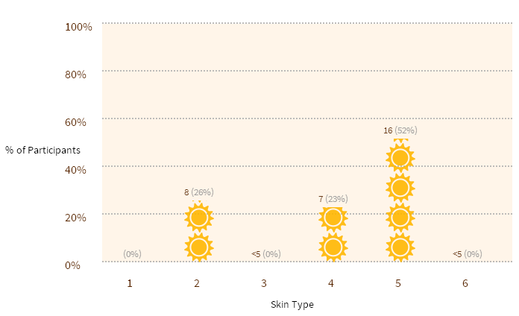






Self Enhancement, Inc.
Let’s Get Healthy! visited Self Enhancement, Inc. on December 5th, 2013 and
collected research data from 278 SEI students and community members.
31 students completed the cancer risk survey and their results are shown below.
Skin cancer is the MOST COMMON
of all cancer types
Anyone can get skin cancer.
Skin cancer risk is influenced by your genetics, skin type and your protection behaviors.
If you have a sensitive skin type (Fitzpatrick Type 1-3), you need to be especially cautious!
Individuals with darker skin (Fitzpatrick Types 4-6) are still at risk! People of color are often diagnosed later, which means the cancer can become more advanced and potentially fatal.
Regular skin checks are important for everyone!
Most skin cancers are curable if caught and treated in a timely manner.
Did you know? Legendary reggae musician Bob Marley dismissed a spot under his toenail as a soccer injury, but it turned out to
be an aggressive form of melanoma
that ultimately caused his death at 36.
FITZPATRICK SKIN TYPES OF SEI COMMUNITY
Just 14% of the SEI participants who completed the survey had “excellent” or “good” sun safety behaviors!
In the last year, 87% of SEI students went to a doctor’s office for a checkup
To see more results from your school and others, please visit: http://www.letsgethealthy.org

