Slide 1

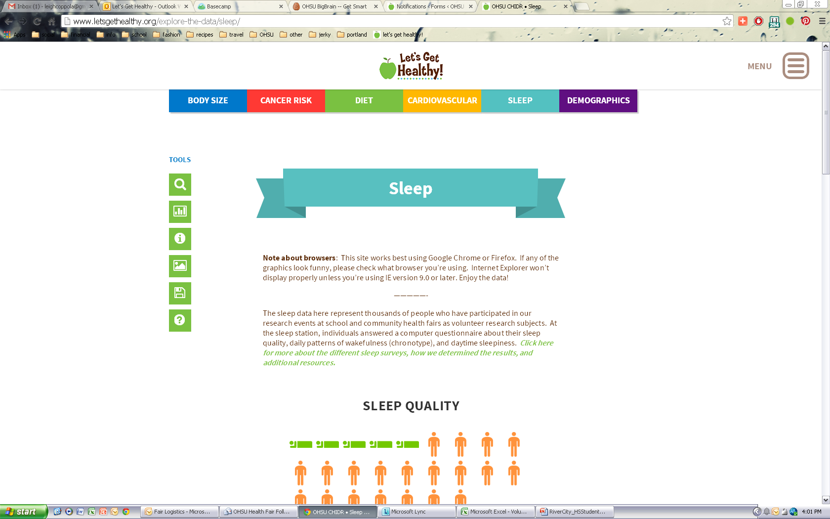
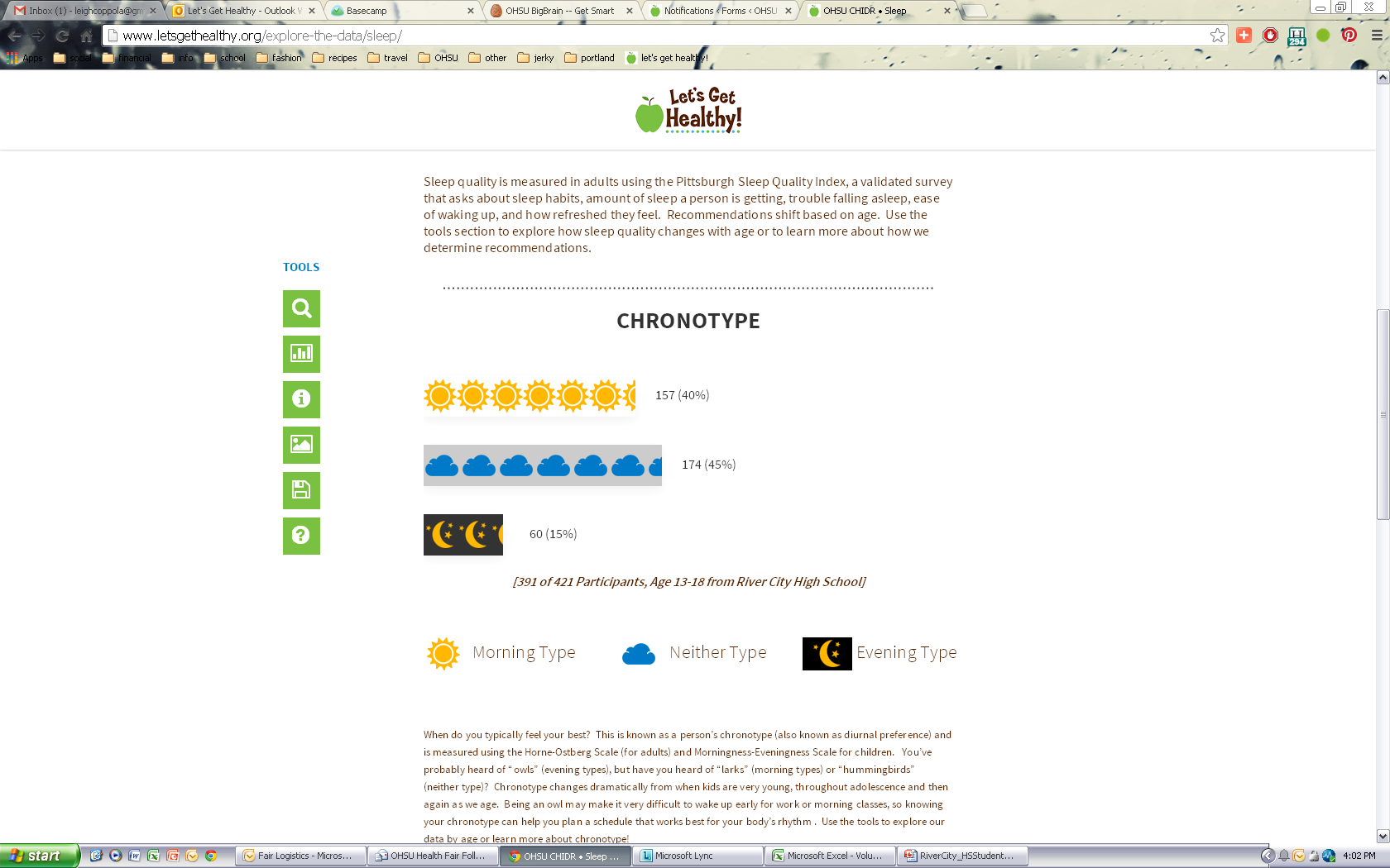
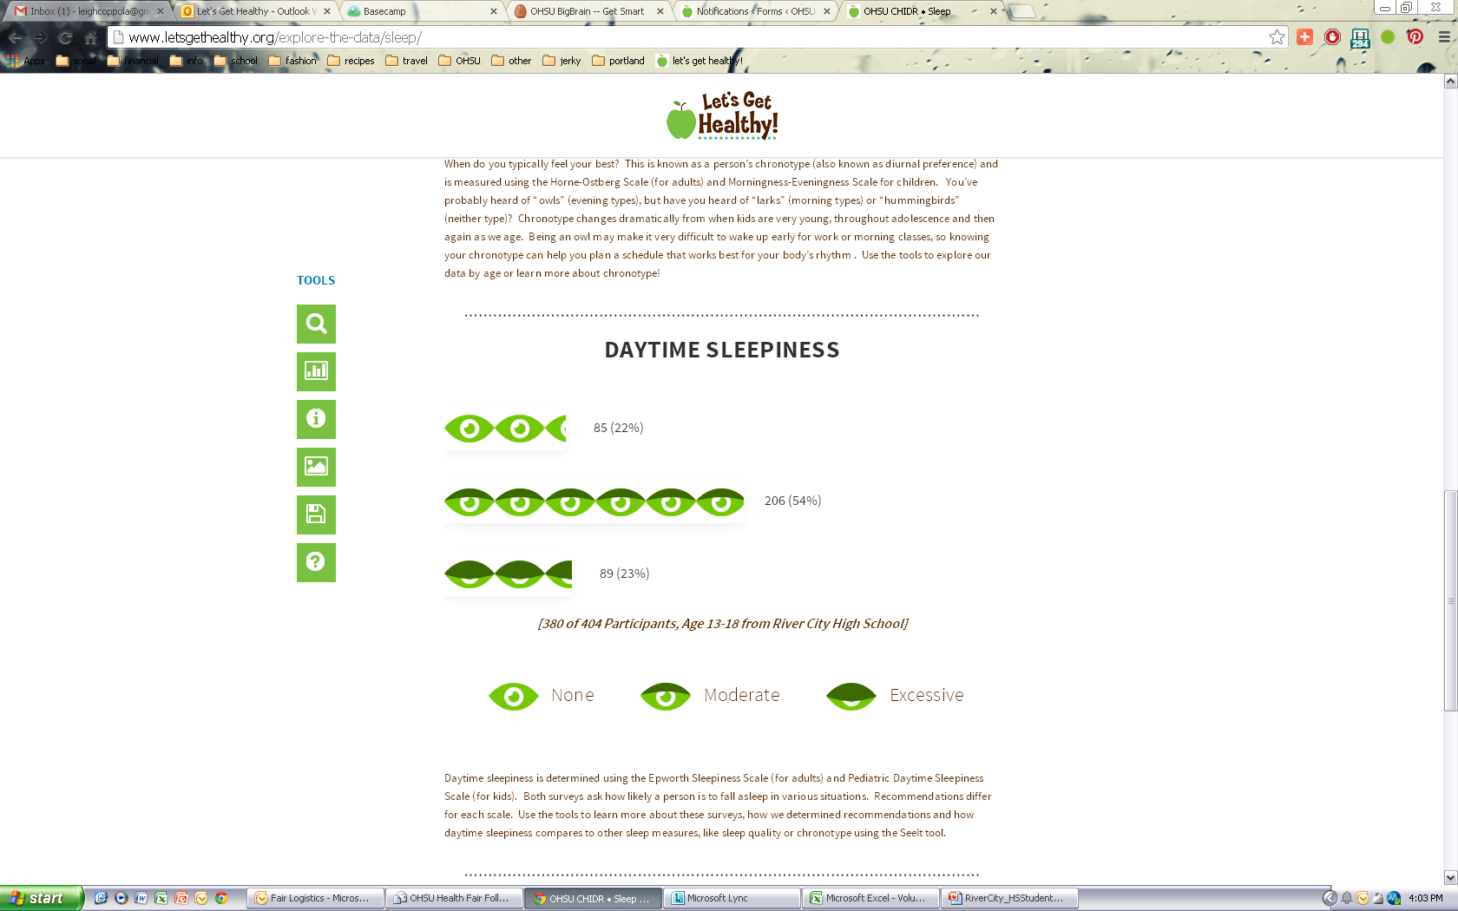








River City High School
Let’s Get Healthy! visited River City High School on September 18th-20th, 2013 and collected research data from 1,550 River City High School students.
About 400 students completed the sleep station and their results are shown below.
On school days, students wake up:
Chronotype (also known as “diurnal preference”) refers to the time of day or night that a person feels at their best.
Average bedtime for students is 11 pm on school nights and midnight on weekends.
20%
of River City High School students leave for school at or before 7:00 am.
Average wake time for students is 6:30 am on school nights and 9:00 am on weekends.
26% of students go to bed at midnight or later on school nights.
3 out of 5 River City students think they need less than 8 hours of sleep!
Did you know?
Teens need about 9.25 hours of sleep each night to function best (for some, 8.5 hours is enough.)
Two out of five students said they thought the students in their school would not meet recommendations for healthy sleep.
7:30 am
The average time River City High School students leave for school.
To see more results from your school and others, please visit: http://www.letsgethealthy.org

