Slide 1
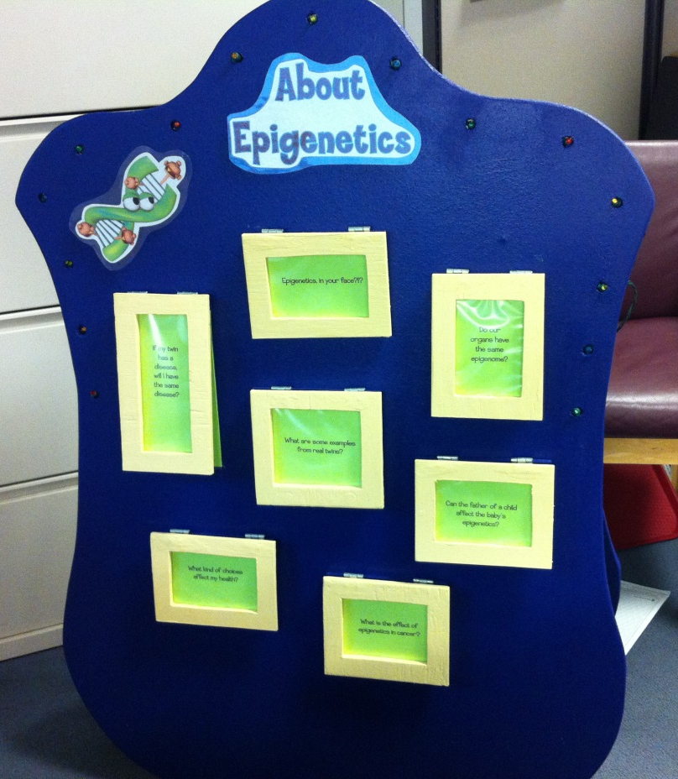
Create your own… Epigenetics Flip Board
Instructions:
Print out the following questions and answers.
(Stiffer paper works best. Font note: “Typography of Coop” was used here but it can be replaced by any font you choose.)
Cut around the boxes
Tape the question page over the answer and affix to a surface (we used a wooden “sandwich board” but it can be poster board or wall. Optional: you can add a paper tab to the question page to make it easier to lift.)

Slide 2
If my twin has a disease,
will I have the same disease?
Box 1 - front

Slide 3
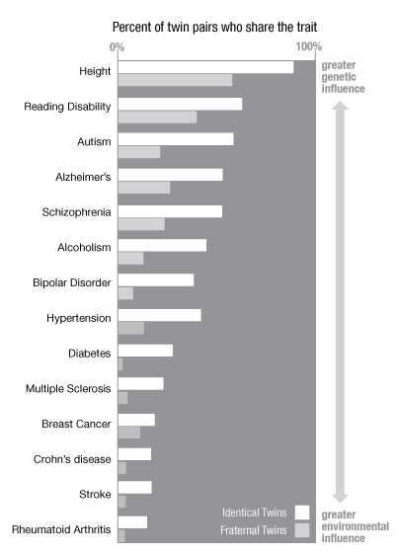
Genetics tell us that there is a high risk of a twin developing the same disease. But our genes are just part of the story.
If a disease was 100% genetic, then both twins should have that disease. Studies from identical twins reveal that some diseases are more sensitive to environmental influences. It turns out that the environment and a person’s choices can influence disease risk by changing the way their DNA works (epigenetics).
http://learn.genetics.utah.edu/content/epigenetics/twins/
Box 1 - under

Slide 4
Epigenetics, in your face?!?
Box 2 - front

Slide 5
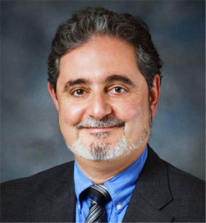
The best example of an epigenetic phenomenon is the face, says
Dr. Jean-Pierre Issa (pictured here).
Skin, eyes, teeth, and hair all look different, but they contain exactly the same genetic information!
http://www.pbs.org/wgbh/nova/body/epigenetic-therapy.html
Box 2 – under

Slide 6
Do our organs have the same epigenome?
Box 3 - front

Slide 7
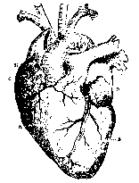
No! New research suggests that our different body systems (our brain, bones, liver, heart, etc.) may all have different epigenomes! While our organs all share the same genome (DNA), the tags on the DNA (epigenome) can be very different between organs.
In the brain, epigenetics is involved in learning and creating ne w memories.
In the heart, epigenetics can play a role in the development of heart disease.
Our bodies have a set of genes turned on during the day and another set of genes turned on at night.
New research suggests that our biological rhythm may be controlled by epigenetics!
Box 3 – under

Slide 8
What are some examples from real twins?
Box 4 - front

Slide 9
Meet Ana Mari and Clotilde from the PBS series “Ghost in Your Genes”.
They came to the studio that day wearing the same red dress without knowing what the other was going to wear. Five years ago, Ana Mari was diagnosed with cancer and Clotilde was not. Scientists looked at their genomes (DNA) and epigenetic tags (epigenomes). They found that their genomes were the same, but their epigenomes were different. Their life experiences had changed the way their DNA worked.
http://www.pbs.org/wgbh/nova/transcripts/3413_genes.html
Box 4 – under

Slide 10
Can the father of a child affect the baby’s epigenetics?
Box 5 - front

Slide 11
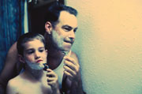
Yes! Scientists have found that the effects of both diet and stress can be passed from a father to his children.
A 2013 study found that a father’s diet can produce epigenetic “tags” on sperm, which influence the long-term metabolism and disease in his children!
http://www.nature.com/nrn/journal/v12/n10/full/nrn3109.html
http://www.ncbi.nlm.nih.gov/pubmed/24326934
Box 5 – under

Slide 12
What kind of choices affect my health?
Box 6 - front

Slide 13
Lots of things!
Food (broccoli, leafy greens, and more!)
Air quality (campfire, smoke, smog)
Stress
Exercise
Hugs (especially for young children!)
Sleep
Exposure to toxins
Your choices matter! Be nice to your genes!
Box 6 – under

Slide 14
What is the effect of
epigenetics in cancer?
Box 7 - front

Slide 15
Our bodies tell our cells when it’s time to grow and when it’s time to stop. For example, when we injure our skin, there needs to be a way to heal the wound and stop cell growth when complete. In cancer cells, this “stop” signal is often gone.
Epigenetics is a way for the environment (like toxins, smoke, etc.) to create “tags” on our DNA, which turns DNA activity up and down. Some “tags” can turn up cell growth while others can turn down the “stop” signals, resulting in cells that continue to grow and divide when they shouldn’t. This happens in cancer. Research is currently studying how to turn these “stop” signals back on and how to slow cancer growth.
Box 7 – under

