Slide 1
Maps and Tables
Let’s Get Healthy

Slide 2
Percent of Obese (BMI > 30) in U.S. Adults

Slide 3
Percent of Obese (BMI > 30) in U.S. Adults

Slide 4
Percent of Obese (BMI > 30) in U.S. Adults

Slide 5
Percent of Obese (BMI > 30) in U.S. Adults

Slide 6
Percent of Obese (BMI > 30) in U.S. Adults

Slide 7
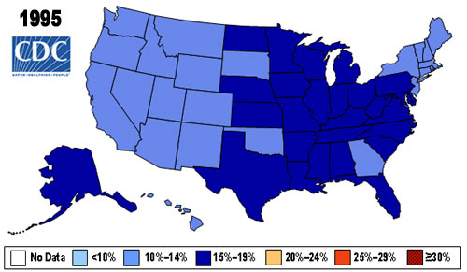
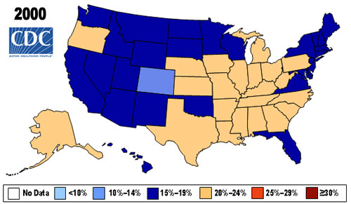
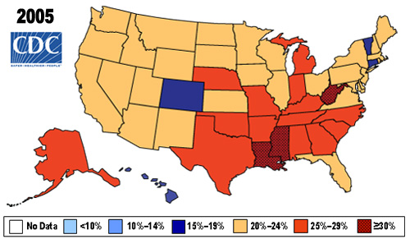
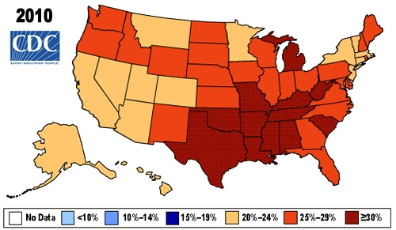
Percent of Obese (BMI > 30) in U.S. Adults

Slide 8
TABLE 1: States with the Highest Rates of Physical Inactivity in Adults
Ranking | State | Percentage of Adult Physical Inactivity Obesity Ranking (Based on 2007-2009 Combined Data, Including Confidence Intervals) | Obesity Ranking
1 | Mississippi | 32.2% (+/- 0.9) | 1
2 | Oklahoma | 30.8% (+/- 0.8) | 6
2 | West Virginia | 30.8% (+/- 1.0) | 4
4 | Tennessee | 30.5% (+/- 1.2) | 2 (tie)
5 | Kentucky | 30.1% (+/- 1.0) | 7
5 | Alabama | 30.1% (+/- 1.0) | 2 (tie)
7 | Louisiana | 29.5% (+/- 0.9) | 5
8 | Arkansas | 29.3% (+/- 1.0) | 8
9 | Texas | 28.0% (+/- 0.8) | 13
10 | Missouri | 26.6% (+/- 1.0) | 12

Slide 9
TABLE 2: States with the Lowest Rates of Physical Inactivity in Adults
Ranking | State | Percentage of Adult Physical Inactivity Obesity Ranking (Based on 2007-2009 Combined Data, Including Confidence Intervals) | Obesity Ranking
51 | Minnesota | 16.9% (+/- 0.9) | 32
49 | Colorado | 18.0% (+/- 0.6) | 51
49 | Oregon | 18.0% (+/- 0.8) | 39
48 | Washington | 18.8% (+/- 0.7) | 28
47 | Utah | 19.0% (+/- 0.8) | 44
46 | Hawaii | 19.1% (+/- 0.8) | 47
45 | Vermont | 19.3% (+/- 0.7) | 46
43 | Idaho | 20.6% (+/- 0.9) | 36
43 | New Hampshire | 20.6% (+/- 0.8) | 35
42 | D.C. | 20.7% (+/- 1.0) | 49

